Slide 1

Segmenting Consumers of Bath Soap
BUS 4023 - Group 6
Professor: Tasnim M Taufique Hossain

Slide 2
OBJECTIVES
To identify the cluster of household based on the variables based on the demographic indicators, Brand Indicators etc using k-mean method.
To classify the customer whether value conscious or not by developing the predictive model.
To find out whether customer care about the price/performance ratio of the product using the decision trees.
To help CRISA to make better informed decision about the clients based either on the purchase behavior or basis of purchase.

Slide 3
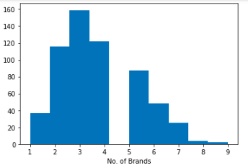
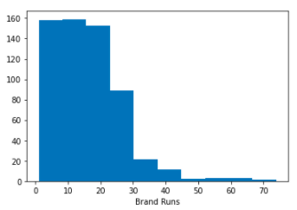
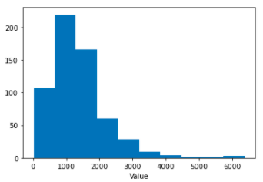
DATA EXPLORATION
--- Purchase Summary over the period
Most of the people would like to purchase 2-5 brands
The number of instances of consecutive purchase of brands are mainly range between 5 to 25
The sum of value is between 1000-2000.

Slide 4
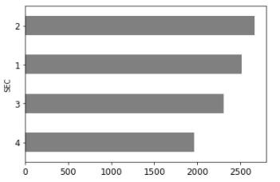
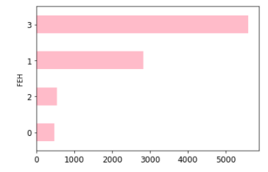
DATA EXPLORATION
--- Demographics and Brand Runs
SEC=1,2 are more likely to become a more consecutive purchaser of a brand.
People who are non-vegetarian appears to be a more consecutive purchaser of a brand.

Slide 5
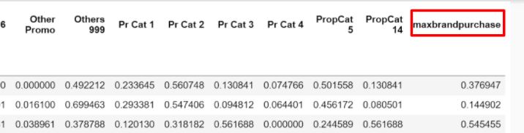
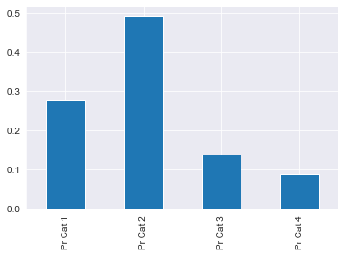
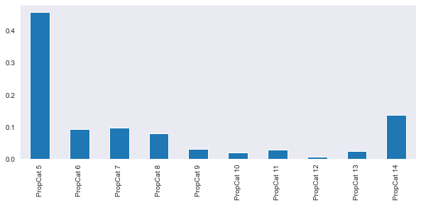
Clustering: Variables Selecting
A customer who buys all brand A just as loyal as a customer who buys all brand B.
The 'maxbrandpurchase' indicates the maximum share devoted to any one brand, which is the maximum value of 8 brand share variables.
Percent of volume purchased under the price category
Percent of volume purchased under the product proposition category
Used all price categories.
Used selling propositions 5 and 14.

Slide 6
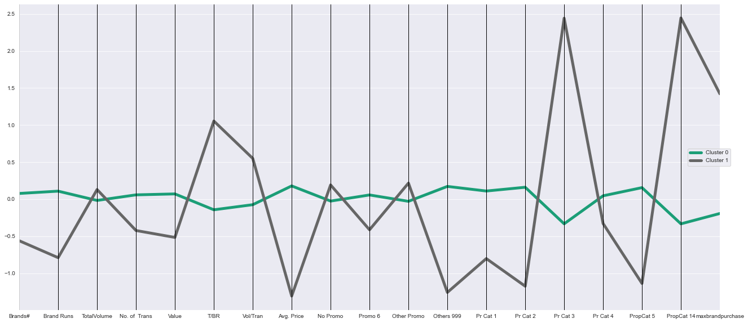
Scenario 1：Segement the Households into 2 Clusters(k=2)

Slide 7

Scenario 1：Segement the Households into 2 Clusters(k=2)
Loyal Price Conscious
Loyal Brand Conscious
Cluster 0 (n=528) is high activity & value, with low loyalty and high susceptibility to discounts, and they like pricing categories 1 and 2 and are somewhat responsive to selling propositions 5. Demographically, they have high socioeconomic status and affluence, and larger households but with less children.
Cluster 1 (n=72) is highly loyal with favoring main brands, be averse to promotions, and responds to pricing category 3 selling propositions 14. Demographically,they with low socioeconomic status and affluence, and smaller households but with more children.

Slide 8
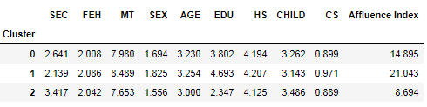
Scenario 2：Segement the Household into 3 Clusters(k=3)
Loyal Brand Conscious
High Purchasing Power
Ordinary Brand Conscious
Cluster 2(n=72) has high brand loyalty with favoring main brands and low value. Highly responsive to price category 3 and selling proposition 14. Demographically, it has low affluence and education with a high number of children in the household.
Cluster 1 (n=280) is not at all loyal but of high value. It is responsive to pricing category 1. Demographically, it has the highest affluent and socioeconomic class with the highest education.
Cluster 0 (n=248) is not very loyal with favoring many brands and responsive to price category 2 and selling proposition 5. Demographically, it is relatively affluent and with lower socioeconomic class. It also has a relatively higher number of members in the household.

Slide 9
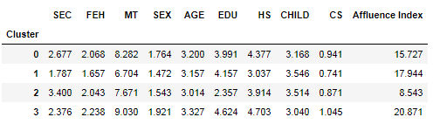
Scenario 3：Segement the Household into 4 Clusters(k=4)
High Purchasing Power
Loyal Brand Conscious
Cluster 2 (n=70) stands out in both groups of variables - it has high loyalty, low value and price per purchase, and very differential response to price (unresponsive to categories 1, 2, and 4, highly responsive to category 3), and selling proposition (unresponsive to #5, highly responsive to #14). ​Demographically, it is low affluent and low education.
Cluster 3 (n=202) is distinguished mostly by the purchase behavior variables - it has low brand loyalty together with high value, volume, and frequency. The brand switching seems to be intrinsic - this group
is not particularly responsive to promotions(only responsive to promotion code 6), pricing, or selling propositions. Demographically it is relatively affluent and educated.
Random Purchaser
Low Purchasing Power
Cluster 0 (n=220) is a "gray" cluster, it is not characterized by very extreme/distinctive values across all variables, but is responsive to price category 2 and selling proposition 5. Demographically, it is relatively affluent and educated.
Cluster 1 (n=108) is characterized by low volume, low loyalty, and sensitivity to price (responsive to cat. 1, unresponsive to 2, 3, and 4), and unmoved by selling proposition. Demographically, it is affluent, of high socioeconomic status, and has a relatively small family size.

Slide 10
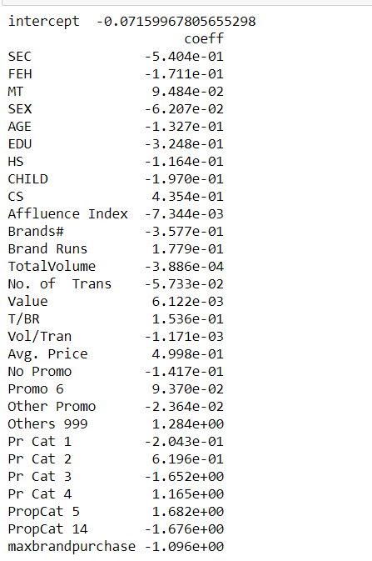
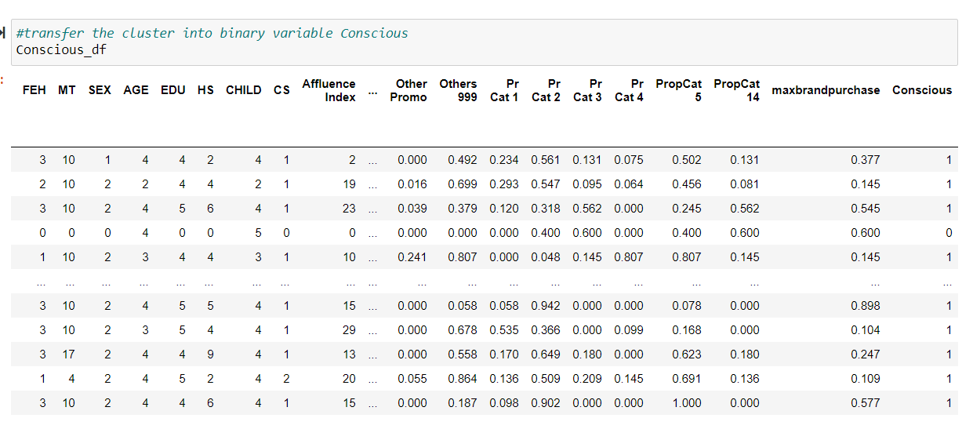
Logistic Regression
Most Positive coefficient
Promo 6
MT
Pr cat 2
Most negative coefficient
Affluence Index
Sex
No. of trans
Intercept:
-0.071599
New binary variable: Conscious
Created by senario 1 cluster
Loyal price or loyal brand conscious

Slide 11
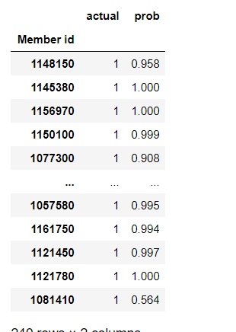
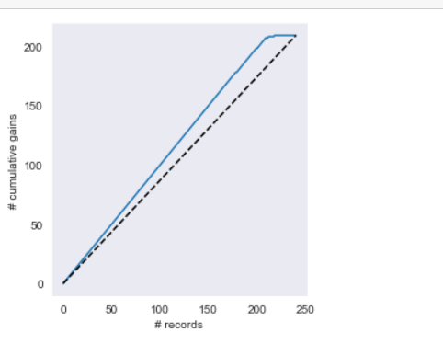
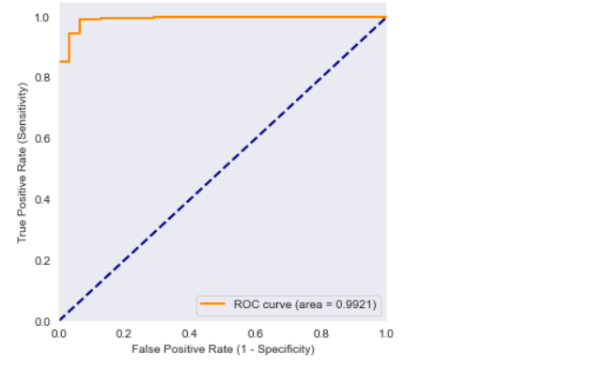
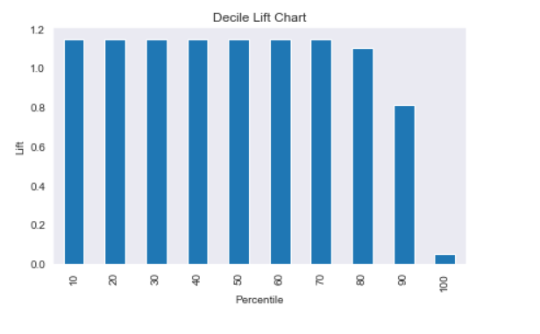
Confusion Matrix
Calculate the possibility for being conscious
ROC Curve
True positive rate stays at 0.8 and stay at one when false positive rate is 0.2
High Accuracy

Slide 12
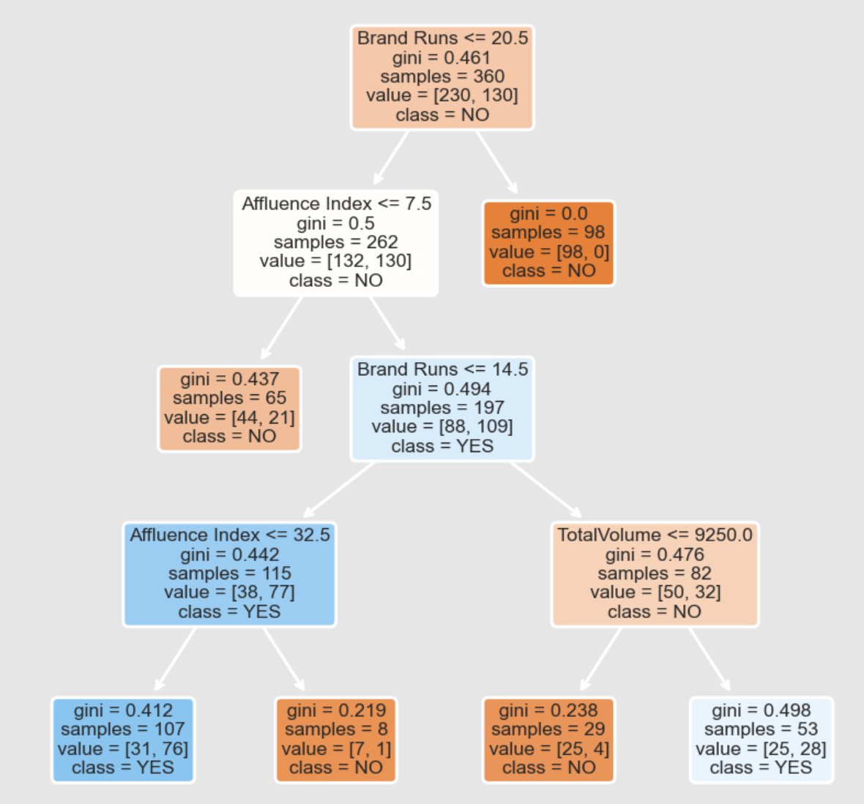
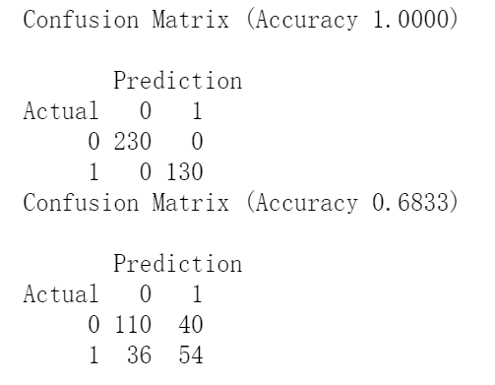
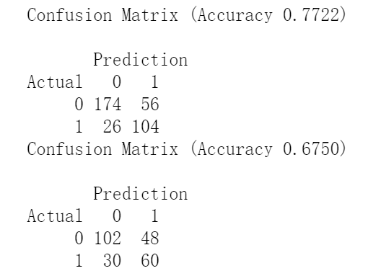
DECISION TREES
Full Class Tree
Small Class Tree
After assessing tree performance, Accuracy has changed from 1 to 0.7722.

Slide 13

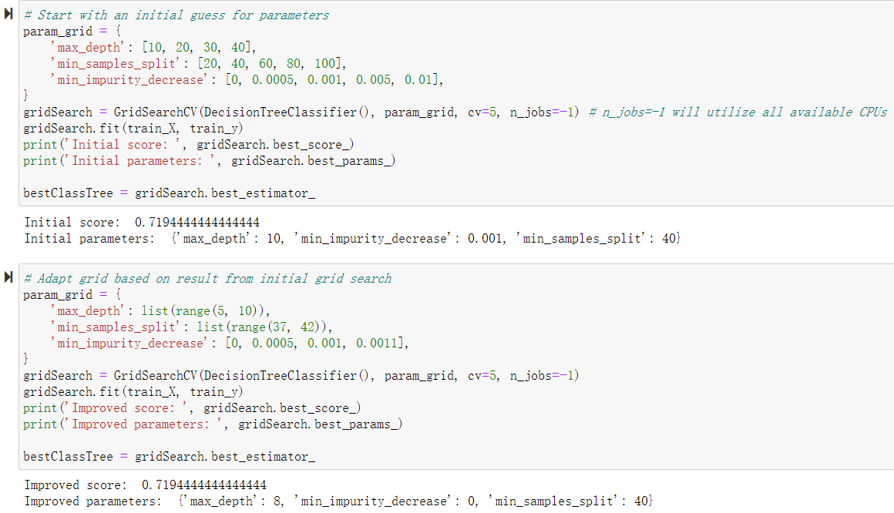

DECISION TREES - GridsearchCV

Slide 14

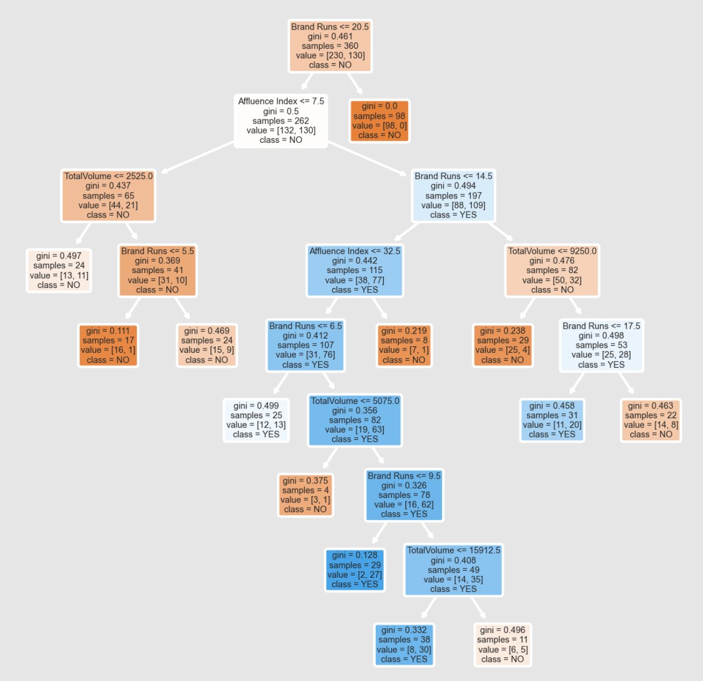
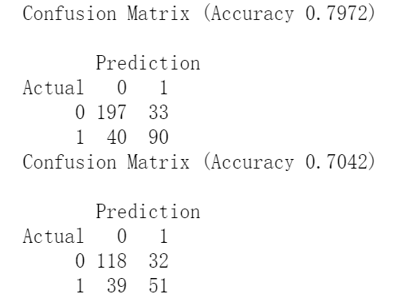
DECISION TREES - Best Class Tree
0.7972
Compared with the accuracy=0.7722 of the second tree, the accuracy=0.7972 of the final tree.

Slide 15
RECOMMENDATIONS
Cluster 0 is responsive only to price category 2 and selling proposition 5, so CRISA need to focus marketing more on other price

Slide 16





Thank you
Ling Cheng
Mingqian Zhou
Chengcheng Cheng
Yi Hu
Pema

